Slide 1
hackers as a high-risk population
@violetblue

Slide 2
Harm reduction methodology
Ways to use it
Hackers at risk

Slide 3
Harm reduction
Harm reduction typically refers to a range of controversial public health policy strategies designed to reduce harmful consequences associated with human behaviors, specifically risky or illegal behaviors.
Conventional criticism of harm reduction is that any tolerance of illegal or risky behavior is a demonstration to society that the risky and illegal behaviors are acceptable.
And possibly even fun.

Slide 4
SFSI.org
SFSI.org is a nonprofit that provides confidential and anonymous sex crisis counseling, as well as training for medical professionals, clinic workers and caregivers.
* Instances include physical trauma and accidents, birth control counseling, gender and orientation crises after sex acts, sexual risk events, taboo or illegal sex acts.
* SFSI methodology applies harm reduction by suspending judgment, and communicating facts and available choices.

Slide 5
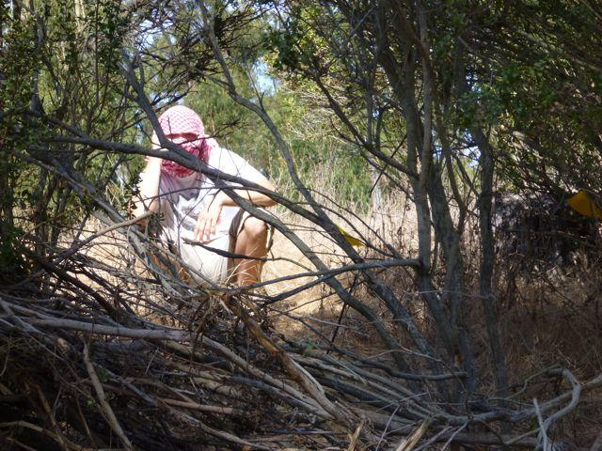
Complex Humanitarian Emergency Training
UCSF's Global Health Master's Program, emergency and crisis trial training for NGO workers, specifically field nurses and doctors.
Live-action simulation of field confrontation in situations such as wilderness training, media training, Geneva Convention training risk assessment situations.

Slide 6
Homeless youth outreach
As a former homeless teen I was asked by a group of neighborhood business associations to moderate forums between neighborhood residents and the homeless youth of Haight (San Francisco), and explain the harm reduction approaches taken by neighborhood homeless youth outreach organizations.
The work: facilitating discussions between neighborhood residents and homeless youth, harm reduction outreach organizations (Larkin Street Youth).

Slide 7
Hackers are the embodiment of disobeying the security regime.
You are uniquely suited to be at-risk to yourselves.

Slide 8
Ilya Zhitomirskiy
"Those putting their reputations on the line, investing so much heart, soul, time, energy and money in these ventures are engaging in high stakes behavior.
It makes sense to me that there is great potential to fall to very low places after investing so much and believing so much in something."
--Dr. Keely Kolmes, Psy.D.

Slide 9
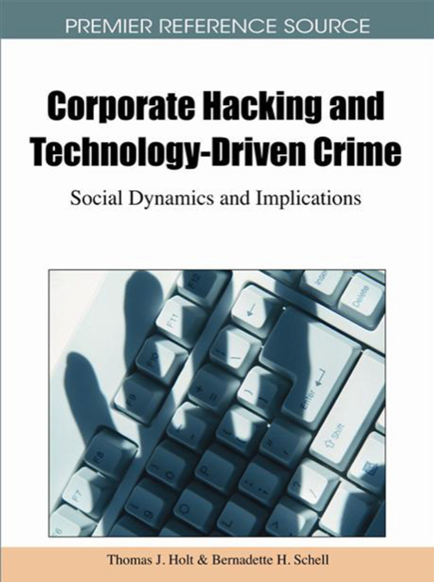

Slide 10
"Are hackers cognitively different?"
Female and Male Hacker Conferences Attendees: Their Autism-Spectrum Quotient (AQ) Scores (2011; pub 2012)
-Bernadette H. Schell, Ph. D. / June Melnychuk, Ph. D.
Teams distributed eight-page surveys at Black Hat and Defcon (2005, 2006, 2007), HOPE 2006, the 2005 Executive Women's Forum for IT Security, and the 2006 IBM CASCON conference.
It is the first psychological study to be performed on non-incarcerated hackers.

Slide 11
The results were middle-ground, with no push toward one extreme of Asperger's prevalence one way or the other.
According to the study, new research suggests that those labeled as Asperger's syndrome individuals may not be "unfeeling geeks" or emotionally and socially deficient.
The Intense World Theory sees the core issue in autism-spectrum disorders as not being a lack of empathy or feeling -- but instead these individuals are having a hypersensitivity-to-affective-experience issue.
Meaning, they feel "too much" in a room full of people and the information comes in too fast than can be comfortably processed. This person would combat social anxiety by focusing on details and switching attention, pulling back in a way that appears to be callous or disengaged but is actually a coping mechanism for overwhelming feelings, and choosing to hide their own.

Slide 12
Hacking is a complicated gift.

Slide 13
* Legal risks.
* Fighting common misperceptions between information sharing and advocacy.
* Lack of support system.
* Can't ask for help.
* Outcasts to society and companies.
* Fighting indifferent institutions.
* Limited communications.
* Hackers are culturally diverse; may not be working in same language of targets, unknowns, or allies.
* Some hackers are more at risk than others (exceptional talent, access).
* High stakes: the high profileness of the info that you have to contain adds a different level of pressure.
* Inner risks: solitary nature of hacking - isolation, depression, impostor syndrome.
* Hackers do things that affect hundreds, thousands of people (often more).
* A moral universe where you're either a player or you get played; you're owning or getting owned.

Slide 14
The long term effects of being secret keepers.

Slide 15
Actions and acts of hacking put the hacker at risk.
Actions and acts of hacking put the hacker's communities at risk.
Actions and acts of hacking put external people (individuals, communities, vulnerable populations) at risk.

Slide 16
lessons from the streets
The code of the streets is a protective mechanism that serves to protect gangsters from arrest as they violate legal codes, but operates in a dual purpose to protect the gangsters and those they care about.
A 'code' puts the focus on individuality as opposed to societally imposed labels.
The most simplified street code is this:
Make paper.
Stay fresh.
Don't snitch.

Slide 17
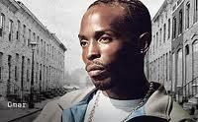
The most detailed explanation of street code was in the portrayal of notorious real-life gangster Donnie Andrews, as depicted through the character Omar Little in HBO’s The Wire.
The underlying theme of the show was Omar's belief that "a man's gotta have a code." This contrasted perceptions of a character who was seen on the outside as a sawed-off shotgun toting terror, and a double-crossing mastermind who outsmarted both the biggest drug dealers and police time and time again.

Slide 18
* Omar is careful to distinguish between players and citizens.
* He never robs or murders people who are not involved in the drug trade.
* His code is not to hurt anyone who is not already in the game.
* Sunday is off limits for killing and robbing.
* Bad people deserve to be punished.
* Truth can’t be subverted to punish bad people.
* No talking on phones about business.
* No loose talk.
* Defend yourself whenever necessary.
* Look out for your own.
* Recon is required: he will scout out a location, sometimes for days, making sure he knows everything about it before he will make his strike.
* Stay sharp: he talks often about how one must do difficult jobs, so as to keep their senses sharpened, their wits too.
* You live by the gun, accept you'll die by the gun.
* Never get high on your own supply.
* Don't snitch.

Slide 19
Instances
Anonymity policies: perfect example of failure to reduce harm.
Transparency/disclosure No one listens to hackers. RainForestPuppy: good example of harm reduction.
Hacker "gentleman's agreements" another good example: reduces risk of a bigger threat to both entities, to limit behavior that is bad for business.
Hacktivism; the use of communication tools by activists and countermovements - “Telling activists not to use centralized email and social media platforms is about as useful as telling teenagers not to use drugs.” See also: OpSec for Hackers by grugq.

Slide 20
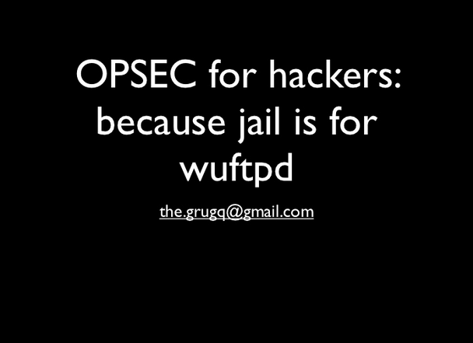
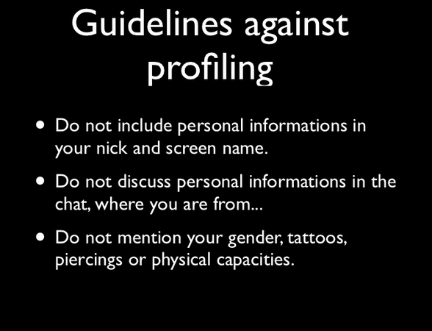
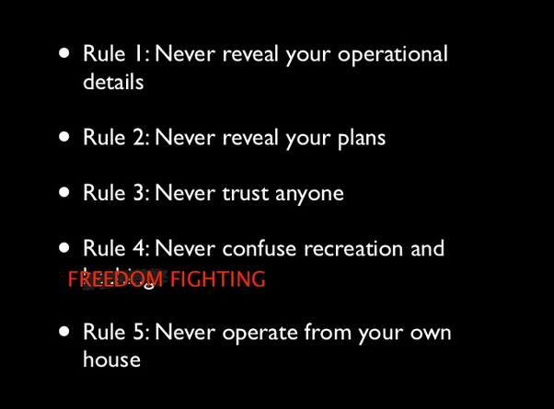
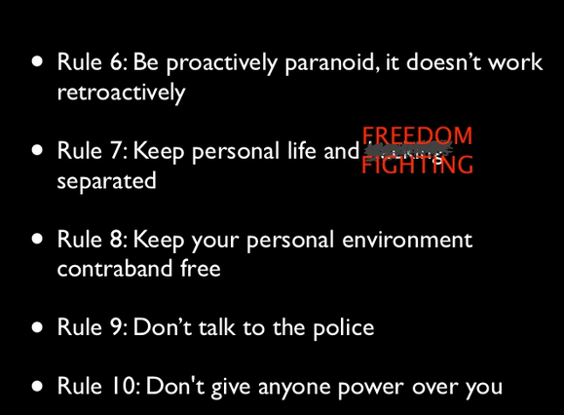
slideshare.net/grugq/opsec-for-hackers

Slide 21
hackers as a high-risk population
@violetblue

